Slide 1
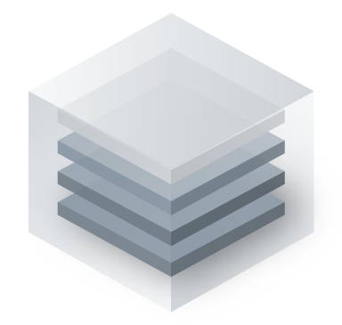
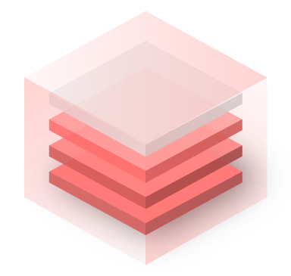
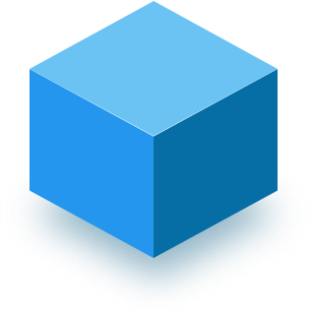
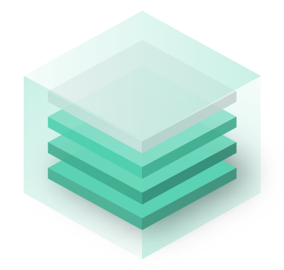
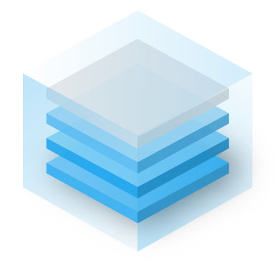
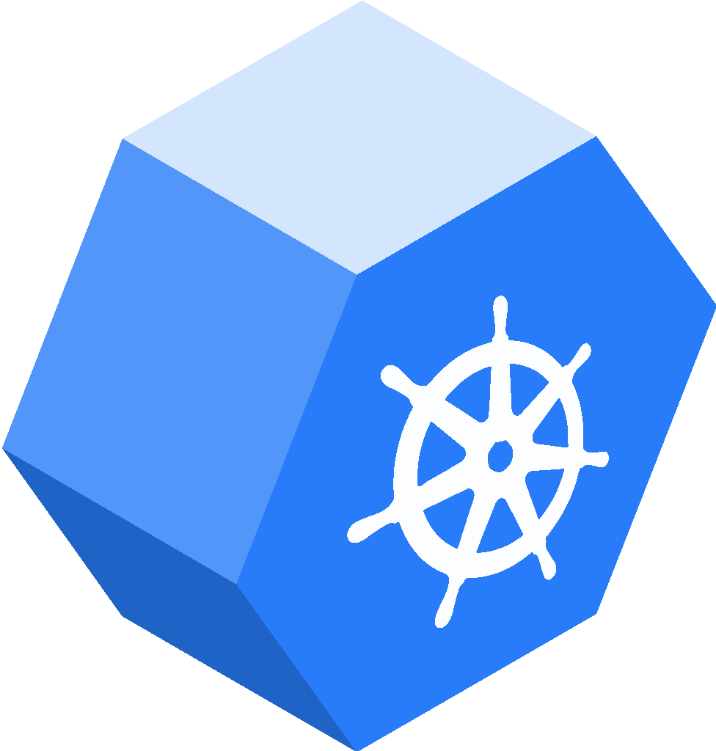
Application Modernization At Scale
Stefan Schinkel Regional Director DACH @ Docker
Notes:
Docker Enterprise: The modern platform for high-velocity innovation
Name, title; I’m here to help you with [what you know about their business their business situation that Docker solves]

Slide 2
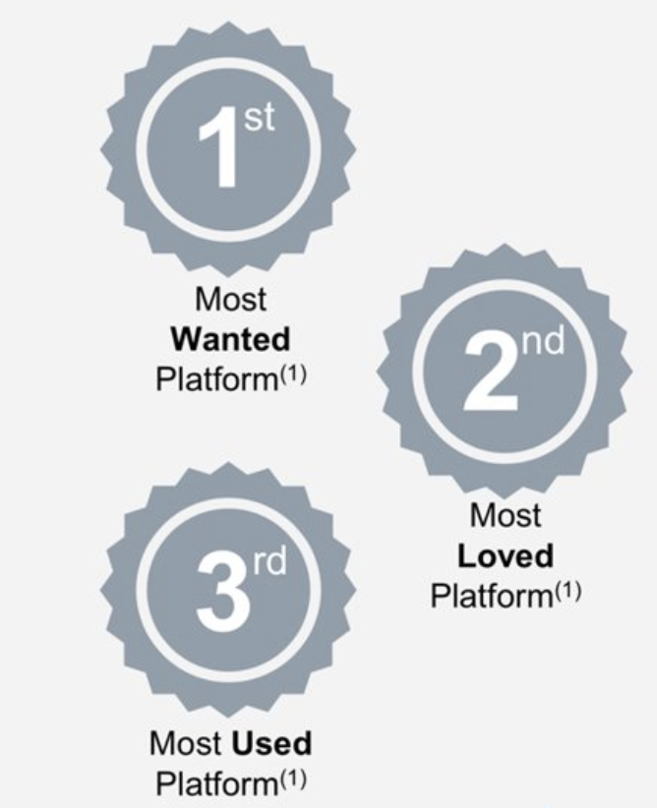
Docker Overview
800+
Enterprise Customers
~380
Employees
1.8+M
Desktop Users
100+B
Cumulative Hub Pulls
San Francisco
Global HQ
London, Paris, Budapest
EMEA offices
Notes:
Stackoverflow survey rankings.

Slide 3
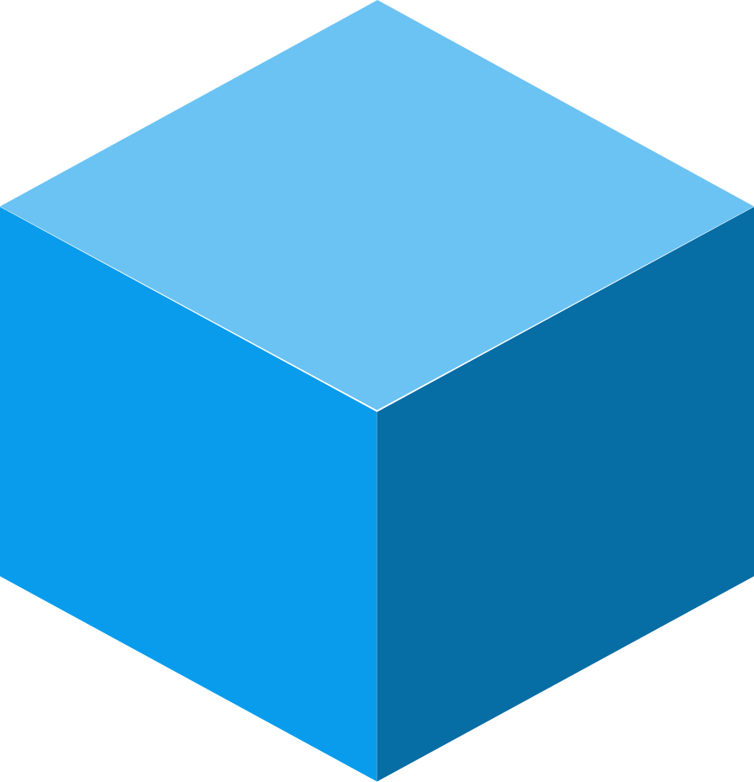
Software is your critical differentiator
Improve the customer experience
Our biggest area of need has been our transformation from what has historically been an industrial manufacturing company … into a software, a hardware and firmware design and manufacturing company.”
Brian Magnusson
VP, Innovation and Technology
Support new business models
Increase operational efficiency
Notes:
Every company is now a software company
To keep up with the pace of change, every company must become a software company. This is the reality today where software has become the foundation for achieving your core business objectives and achieving competitive advantage- it’s what enables you to deliver and scale innovation across the business.
Many of our customers today are in the midst of this transformation. One example I’d like to share is Lindsay Corporation, a traditional industrial manufacturing company that recognizes this need and now considers themselves a software ...

Slide 4
Challenges with Modern App Delivery
01
New Tech Stacks
How do you keep up and adopt new technologies?
02
Distributed Apps → Distributed Teams
How do you collaborate?
03
Different Application Frameworks
How do these pieces interoperate?
04
Dev to Ops Handoff
Can this be easier?
05
Hybrid/Multi-Cloud Differences
How do we reduce churn?

Slide 5
Modern Apps: Shifting to Microservices
Shopper UI
Billing
Traditional Monolithic
Shopper UI
Billing
Mobile Interface
Shopper History
Inventory
Mgmt
Shopper History
Inventory
Mgmt
Notes:
Challenge with die-cast car (monolithic apps):
Difficult to modify for small changes
Complexity increases with each change
Difficult to be agile (slow build and deploy times)
With microservices:
Just swap the part with what you want
Can swap parts at any time (no dependency on rest of the app)

Slide 6
A new application packaging framework
Bundle the multiple and distributed resources along with necessary parameters that comprise a modern application into a single immutable package.
Benefits
Manage multi-service applications with the familiar Docker workflow
Improve collaboration with a clear system-of-record for complex applications
Based on CNAB - an open source standard to support
Simplify deployments to any infrastructure with defined and adjustable application parameters
Docker Application
APP DESCRIPTION
CONTAINERS AND CODE
ENVIRONMENT PARAMETERS
Notes:
Introducing the Docker Application: A Modern Application Framework
At the center of the Docker Platform workflow is the Docker Application. The Docker Application is a packaging framework that defines how distributed resources can be packaged as a single application unit for cloud-agnostic deployment
This helps companies scale operations and provide clear working models for how multiple teams collaborate on microservices.
Simplicity
Docker is bringing the ease of containers to entire applications with Docker Applications.
Simplify the complexity of modern applications by enabling developers to bundle the many distributed resources that comprise a modern application into a single unit that can be easily shared, installed and run in any cloud.
Docker Applications deliver a clear system-of-record that can be shared through Docker-based registries and deployed across multiple clouds and infrastructure.
Choice
Docker App is an implementation of CNAB - an open source standard that is co-sponsored by Docker, Microsoft, Hashicorp and others
Allows Docker Applications to support more than containers in the future, including things like serverless functions, cloud-based ML services
Docker App includes environment parameters that can be adjusted based on where it is deployed - It’s the way to define modern applications once to deploy anywhere.

Slide 7
Modern Apps: Shifting to DevOps
Code
Dockerize
Deploy
Run
SILOED
Dev Team
Ops Team
Dev Team
DevOps Team
Ops Team
Dev Team
DevOps Team / CI/CD
Ops Team
DEVOPS
DevOps Team / CI/CD

Slide 8
App
App
App
Applications
Go Live
App in
Prod
App in
Prod
App in
Prod
Scale
Pipeline
Platform
Operationalizing Containers
Assessment
Governance
Notes:
Docker has developed an outcomes based methodology that was derives from working with real customers on container implementation. It’s a comprehensive approach based on 4 workstreams - Governance, Pipeline, Platform and Applications. The aim of these workstreams is to establish and operationalized platform on which you can containerize and on-board production ready apps

Slide 9
Modern Apps: Shifting to “Cattle”
CATTLE
PETS
10282.server
29304.server
blue.server
green.server
...
App2
App1
App1
App2
App1
App2
1428.server
1580.server
App2
App1
...
App1
App2
Notes:
This can change the runbooks, operating model, and automation of the infrastructure

Slide 10
A Framework for Modernizing Apps
AN END-TO-END CONTAINER PLATFORM FOR BUILDING, SHARING AND RUNNING MODERN APPLICATIONS
Build any application
Share seamlessly
Run anywhere
Docker Desktop as the access portal for dev Docker App for modern applications
Docker Hub & DTR is the place to start, share, promote containers and applications
UCP for managing Hybrid Applications
Docker Engine to run anywhere
DKS orchestration across the platform
Notes:
We are happy to announce the general availability of Docker Enterprise 3.0 - the next major leap forward for the Docker Enterprise platform
The Docker Platform is the industry-leading container platform for continuous, high-velocity innovation, enabling organizations to seamlessly build and share any application — from legacy to what comes next — and securely run them anywhere.
And Docker Enterprise is the only end-to-end platform for building, sharing and running modern container-based applications, from the developer’s desktop to the cloud and managing the entire application lifecycle at every stage.
It supports any application --broadest spectrum of applications, types, profiles, including your legacy Java applications and .NET to microservices and cloud-native applications, all on a single platform,
And designed to run those applications in a way that makes sense for your business - this means having being able to run in any environment - cloud, virtual machine, bare metal and even at the edge.
But before we go into the details of the platform let’s review what problem we’re actually solving.

Slide 11
You Need a Modern Application Lifecycle Enabled by Docker Enterprise 3.0
DOCKER DESKTOP ENTERPRISE
DOCKER HUB
DOCKER TRUSTED REGISTRY
UCP
DOCKER ENGINE + DOCKER KUBERNETES SERVICE
Build
Define and package multiple images and their interdependencies
Share
Collaborate and distribute via Docker Hub and Docker Trusted Registry
Shareable applications with clear interfaces for operators
Run
Run multiple versions of the same application and manage per-environment settings
On-Premise, Cloud, Hybrid
Kubernetes

Slide 12
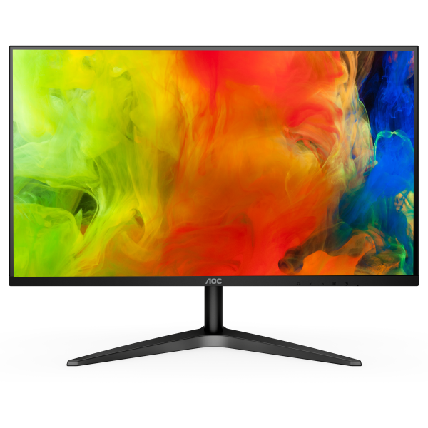
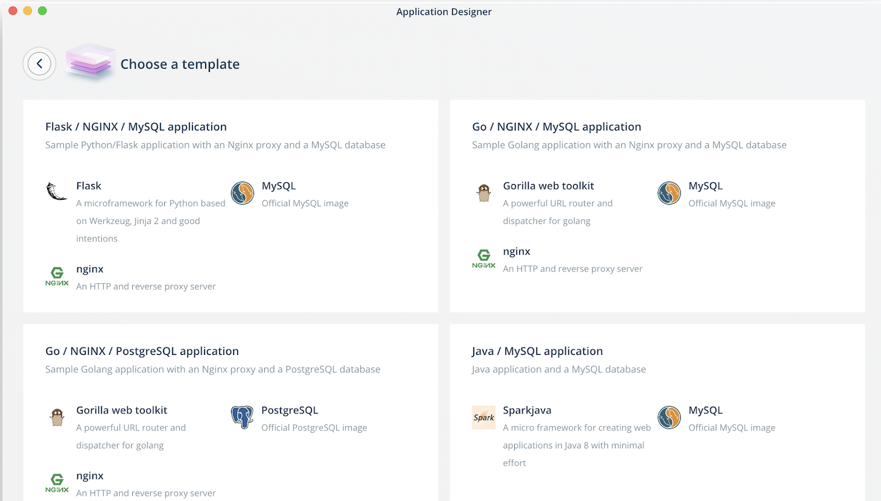
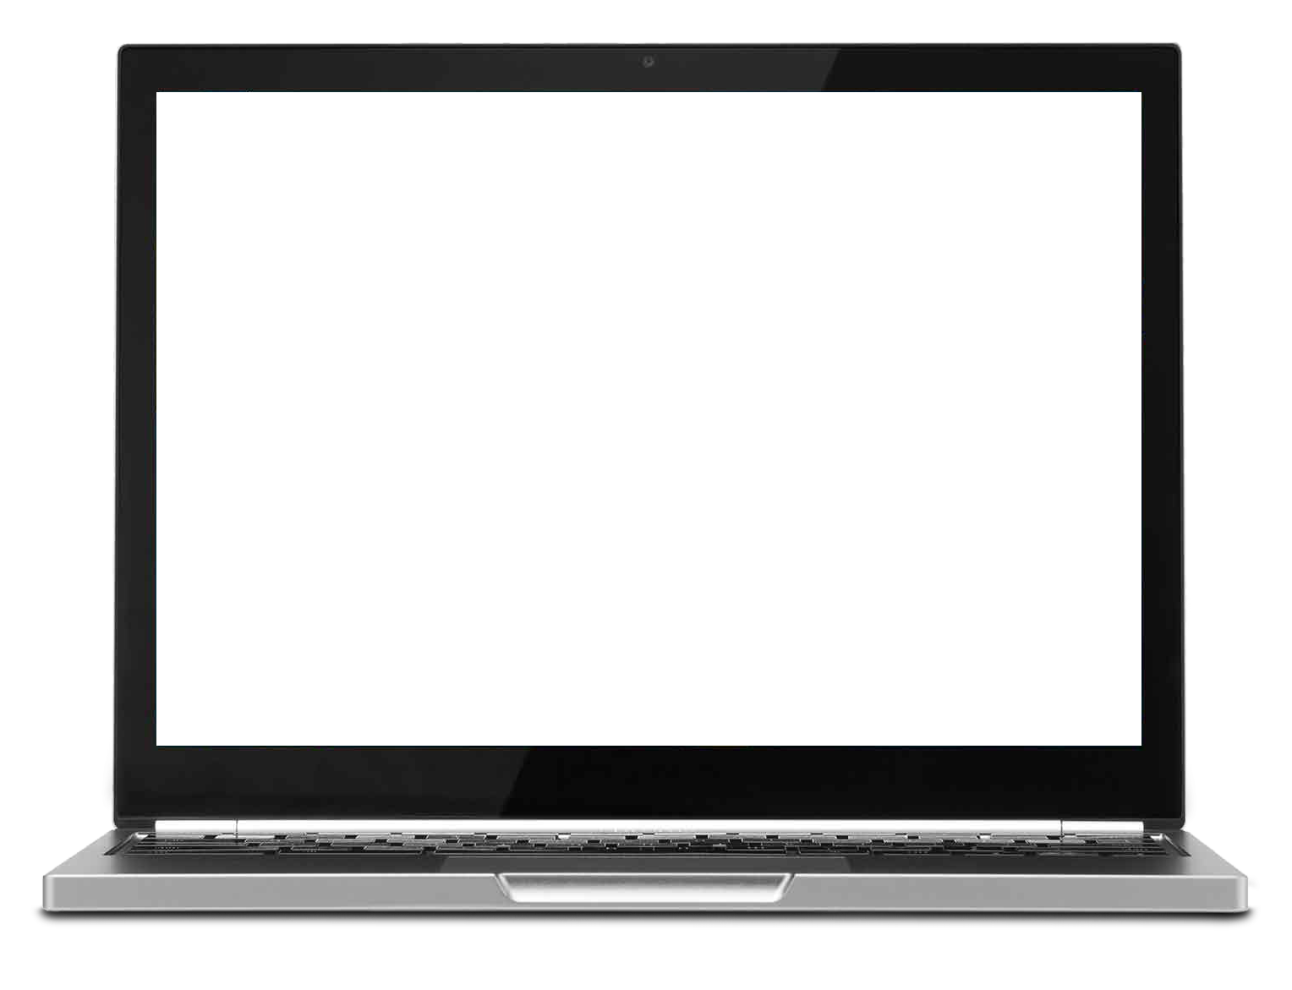
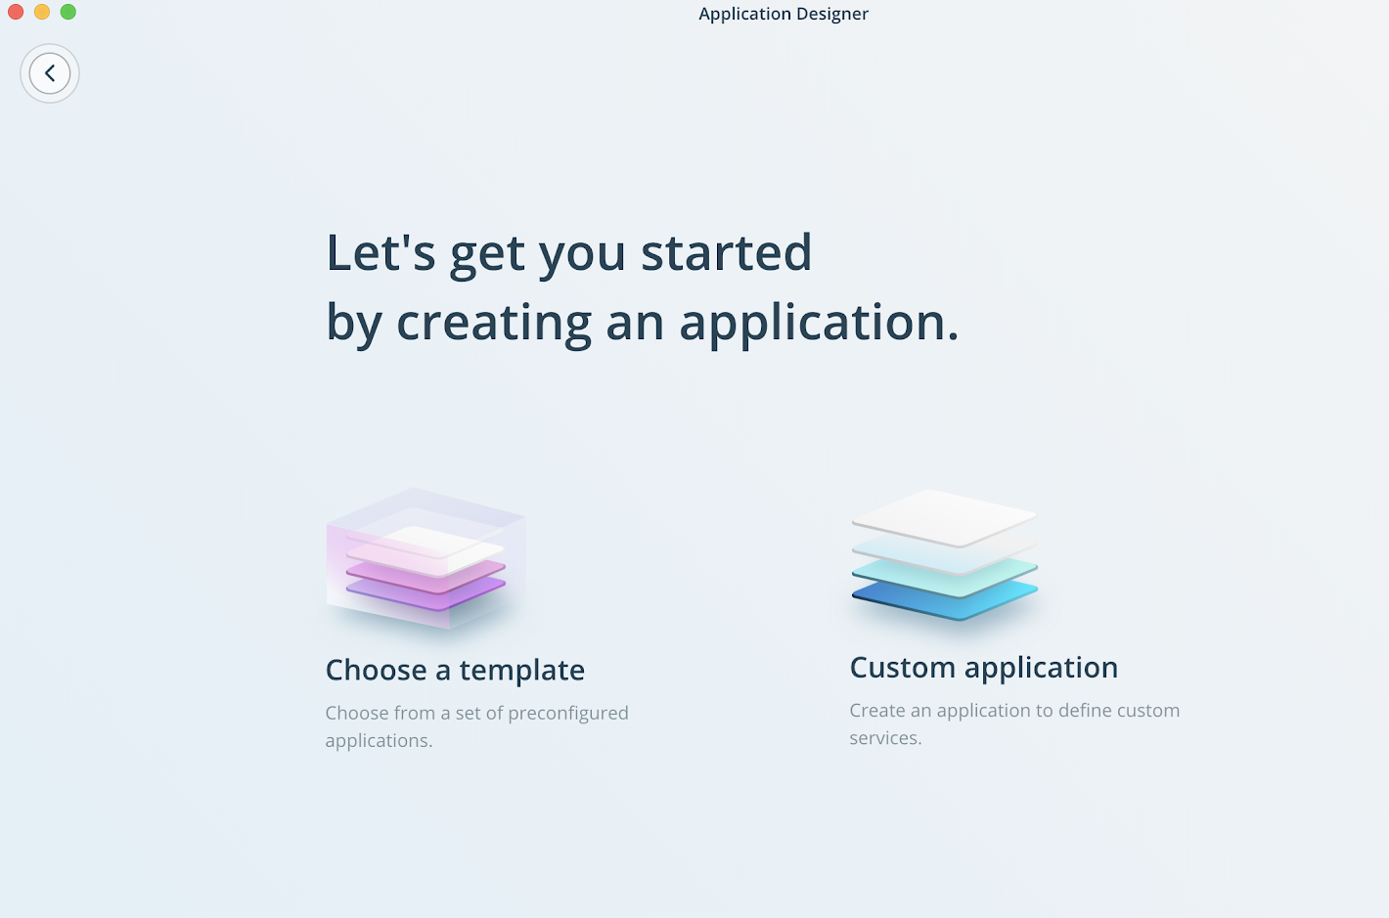
The fastest, easiest and most secure way to build containerized apps
Comprehensive local container application development
Local certified Docker Kubernetes Service (DKS)
Shareable and reusable Docker Application Templates
Standardized deployment and configuration of developer environments
Docker Desktop Enterprise
Notes:
Docker Desktop Enterprise
Enterprise management & security, developer productivity, local Kubernetes runtime
If / when customers ask, “What’s new in Docker Enterprise 3.0?” … this, Docker Desktop Enterprise (DDE), is the biggest ‘new’ thing.
Significant value for customers in having a complete, end-to-end platform, from desktop to production, because it enforces app runtime environment consistency from beginning to end.
Significant differentiation: Neither Pivotal nor Red Hat yet have a commercially-supported desktop developer environment.
The three major feature categories:
Enterprise management & security
Enterprise IT requires that they, not the developers, control developer’s desktops so as to try and minimize security risks.
Docker Desktop Community does not provide for any control by centralized IT.
Docker Desktop Enterprise is delivered in standard formats (PKG, MSI) that can be managed by centralized IT tools to roll-out, install, configure, upgrade, and secure DDE on developer desktops.
Developer productivity
While each customer typically has a small group of Docker experts, automation tools in DDE are designed to enable the non-Docker experts so that all developers at the customer can be productive and successful with Docker.
Specifically, DDE automation tools (see list below), automatically generate all the Docker “scaffolding” developers need to containerize their apps, ie, Dockerfiles, Docker Compose files, CI pipeline configurations, and Docker images.
Customer business value: Non-Docker expert developers can stay focused on building their applications while still realizing the benefits of the Docker Enterprise platform.
The Docker Enterprise platform’s ability to enable developer productivity while not constraining developers to specific app frameworks (as the PaaS vendors, Pivotal PCF and RH OpenShift, do), a significant differentiator.
Local Kubernetes runtime
Standard, certified Kubernetes - not a fork (in contrast to Red Hat OpenShift …)
Local instance of Kubernetes (and Docker) enables developers to rapidly iterate their “write code - compile code - test app” cycle (aka “inner loop”)
DDE enables developers to match their local Kubernetes (and Docker) environment with the UCP production ops environment for Kubernetes (and Docker). Keeping dev and ops environments consistent reduces friction between developers and ops, enabling faster delivery of applications into production.
The five text blocks on the side speak to specific elements of the above ...
Native local …
The foundation of DDE
“Automated, template-driven” means the following tools ...
Docker Application Designer
Docker Application Templates
Docker Pipeline
Docker Assemble
Match desktop and server environments …
See “keeping dev and ops environments consistent” point above
Centrally manage deployment, upgrades, and configuration
… via Windows MSI and Mac PKG packages, popular formats for enterprise desktop management tools
Commercial enterprise support
… Business Day only
Heads-up
Some enterprise customers, for security reasons, do not allow their developers to run Docker (or Kubernetes) locally on their desktops (as diagrammed in the DTR slide). In these situations, the “inner loop” of the developers “write code - compile code - test app” happens in a “development cluster” that the developer logs in to, not on their desktop. Don’t panic ;-). The Docker Enterprise platform is still relevant in this case (and would enable a “development cluster”), but the customer’s interest in DDE could be less than those customers who allow their developers to execute “inner loop” locally on their desktops.

Slide 13
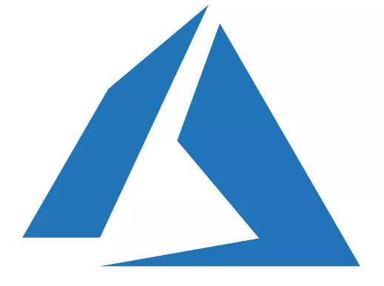
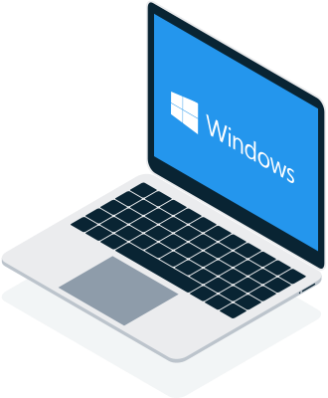
Seamlessly find and securely share certified and approved container content
Tap approved container content from Docker Hub to support a diverse set of applications stacks
Seamlessly share applications in a globally consistent private content repository (Docker Trusted Registry)
Trust the provenance of all applications and ensure secure separation of concerns
Automate container image supply chain for improved security, governance, and faster delivery - anywhere
Docker Hub and Trusted Registry
hub
z
Official and Verified Images
DKS
Docker Desktop Enterprise
Developer app containers
Docker Trusted Registry
Securely run anywhere
Binary image Scanning
Policy-based Promotion
Signing
Mirroring and caching
Notes:
Docker Trusted Registry (DTR)
Secure, scalable container image registry for enterprise software supply chains
Key talking points
App Flow Diagram
The diagram illustrates an example high-level app flow from DDE on the developer’s desktop => DTR => UCP / Engines. Customers will have variations on this. This flow is typically automated and triggered by the developer making a change to their code (the arrow from DDE to git). This is a good opportunity to ask them to diagram their flow.
Security
DTR / Docker Hub are the foundation of the secure software supply chain. Key capabilities include:
Container image vulnerability scanning service to detect security vulnerabilities as early as possible in the app development process.
Container image signing service (aka “Notary”) to track image changes and verify image integrity.
Fine-grained role-based access control (RBAC). Enables multiple developers, development teams, and ops teams to all share container images and collaborate around container image development, testing, and deployment without stepping on each other’s toes.
Docker Hub Certified Container Images. Docker Hub provides digitally-signed, certified container images actively maintained by Docker and third-party ISVs to serve as “building blocks” or starting points for the customer’s own container images that they maintain in DTR.
Automation
Customers aspire to automate as much of the app workflow as possible so as to deliver apps faster while adhering to corporate security and resource consumption policies, which are enforced through automation.
DTR integrates well with the customers existing CI/CD automation tools, eg, Jenkins.
DTR itself automates promoting the container images to different stages of the app workflow based on rules configurable by the customer.
Scaling container image distribution
Global enterprise customers often have development teams and datacenters spread out around the world.
To enable rapid delivery of the right container images to the right group at the right time, DTR provides built-in caching, mirroring, and replication functionality configurable by the customer.
Container Content
Leverage validated and secure container content from Docker Hub to support a diverse set of application stacks and infrastructures
Access to Docker Certified and Verified Publisher content
Heads-up
Some enterprise customers, for security reasons, do not allow their developers to run Docker (or Kubernetes) locally on their desktops (as diagrammed above). In these situations, the “inner loop” of the developers “write code - compile code - test app” happens in a “development cluster” that the developer logs in to, not on their desktop. Don’t panic ;-). The Docker Enterprise platform is still relevant in this case (and would enable a “development cluster”), but the customer’s interest in DDE could be less than those customers who allow their developers to execute “inner loop” locally on their desktops.

Slide 14
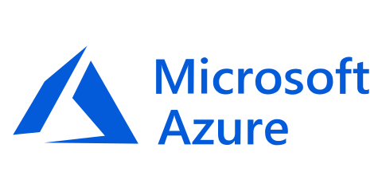
Deploy, manage and secure globally consistent Kubernetes environments that run on any cloud
Rapidly deploy Kubernetes clusters to any cloud with secure defaults out-of-the-box, without being an expert
Consistent and commercially supported Kubernetes from the developer’s desktop to production servers
Management Plane to centrally manage and operate containerized applications
Lifecycle Management to automate and expand deployment of Kubernetes
Docker Kubernetes Service
Certified Kubernetes Distribution
Notes:
Docker Kubernetes Service
Key talking points
Standard, certified Kubernetes
Why does customer care? Market awareness of our support for Kubernetes is low; good to hit this explicitly.
Reference again that it matches the Kubernetes (and Docker) version in DDE - a differentiator.
Industry-leading Windows container support
Why does customer care? Most enterprise customers have a mix of both Windows and Linux workloads. Docker Enterprise gives the customer a platform can handle both, which significantly simplifies their operations.
Differentiator: Neither Pivotal PKS nor RH OpenShift (yet) have GA Windows container support.
Docker Enterprise has been supporting Docker Windows containers in production at scale for two years - no other vendor can say this.
Features
A Certified Kubernetes Distribution (Docker Kubernetes Service)
Highly scalable management plane
Lifecycle automation tools
Run and manage multiple versions of the same application across hybrid-cloud environments
Simplest to use
Manage Docker clusters and applications through a single interface and automate deployment of modern applications to any infrastructure with Day 1 and day 2 automation tools
Easy to use and secure Kubernetes with sensible secure defaults
Most choice
Any operating system: Windows or Linux
Any infrastructure - bare metal, VM, hybrid-cloud

Slide 15
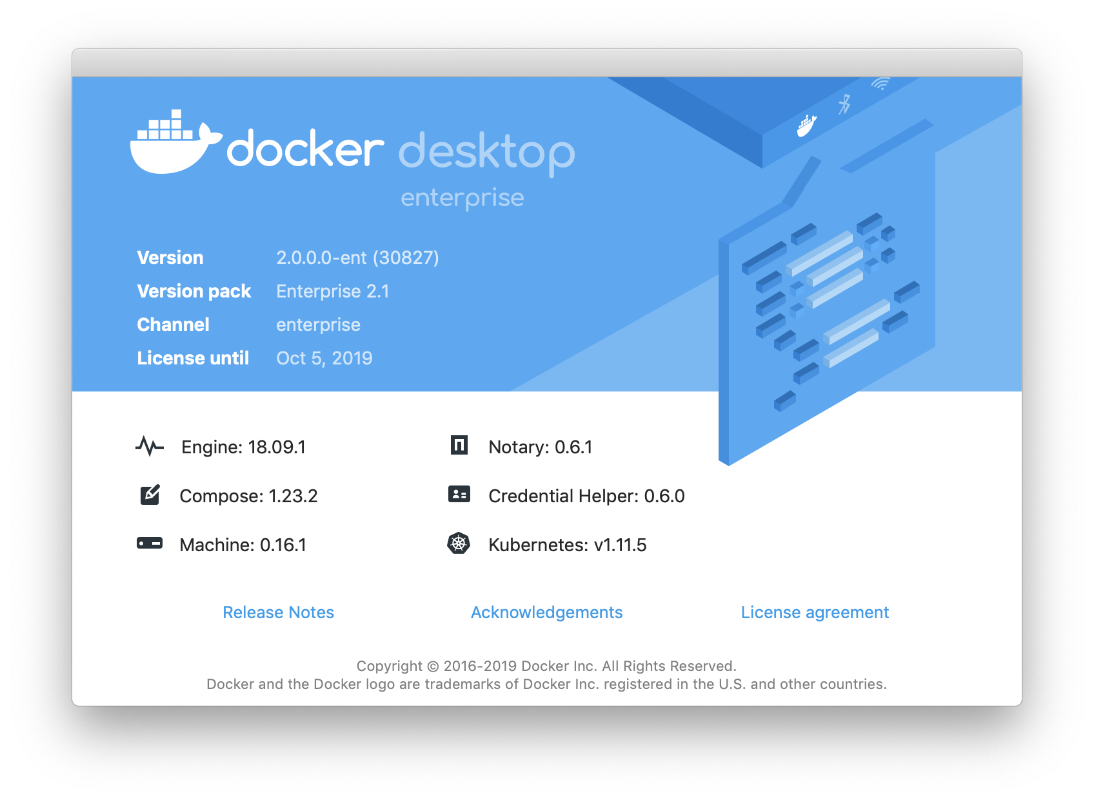
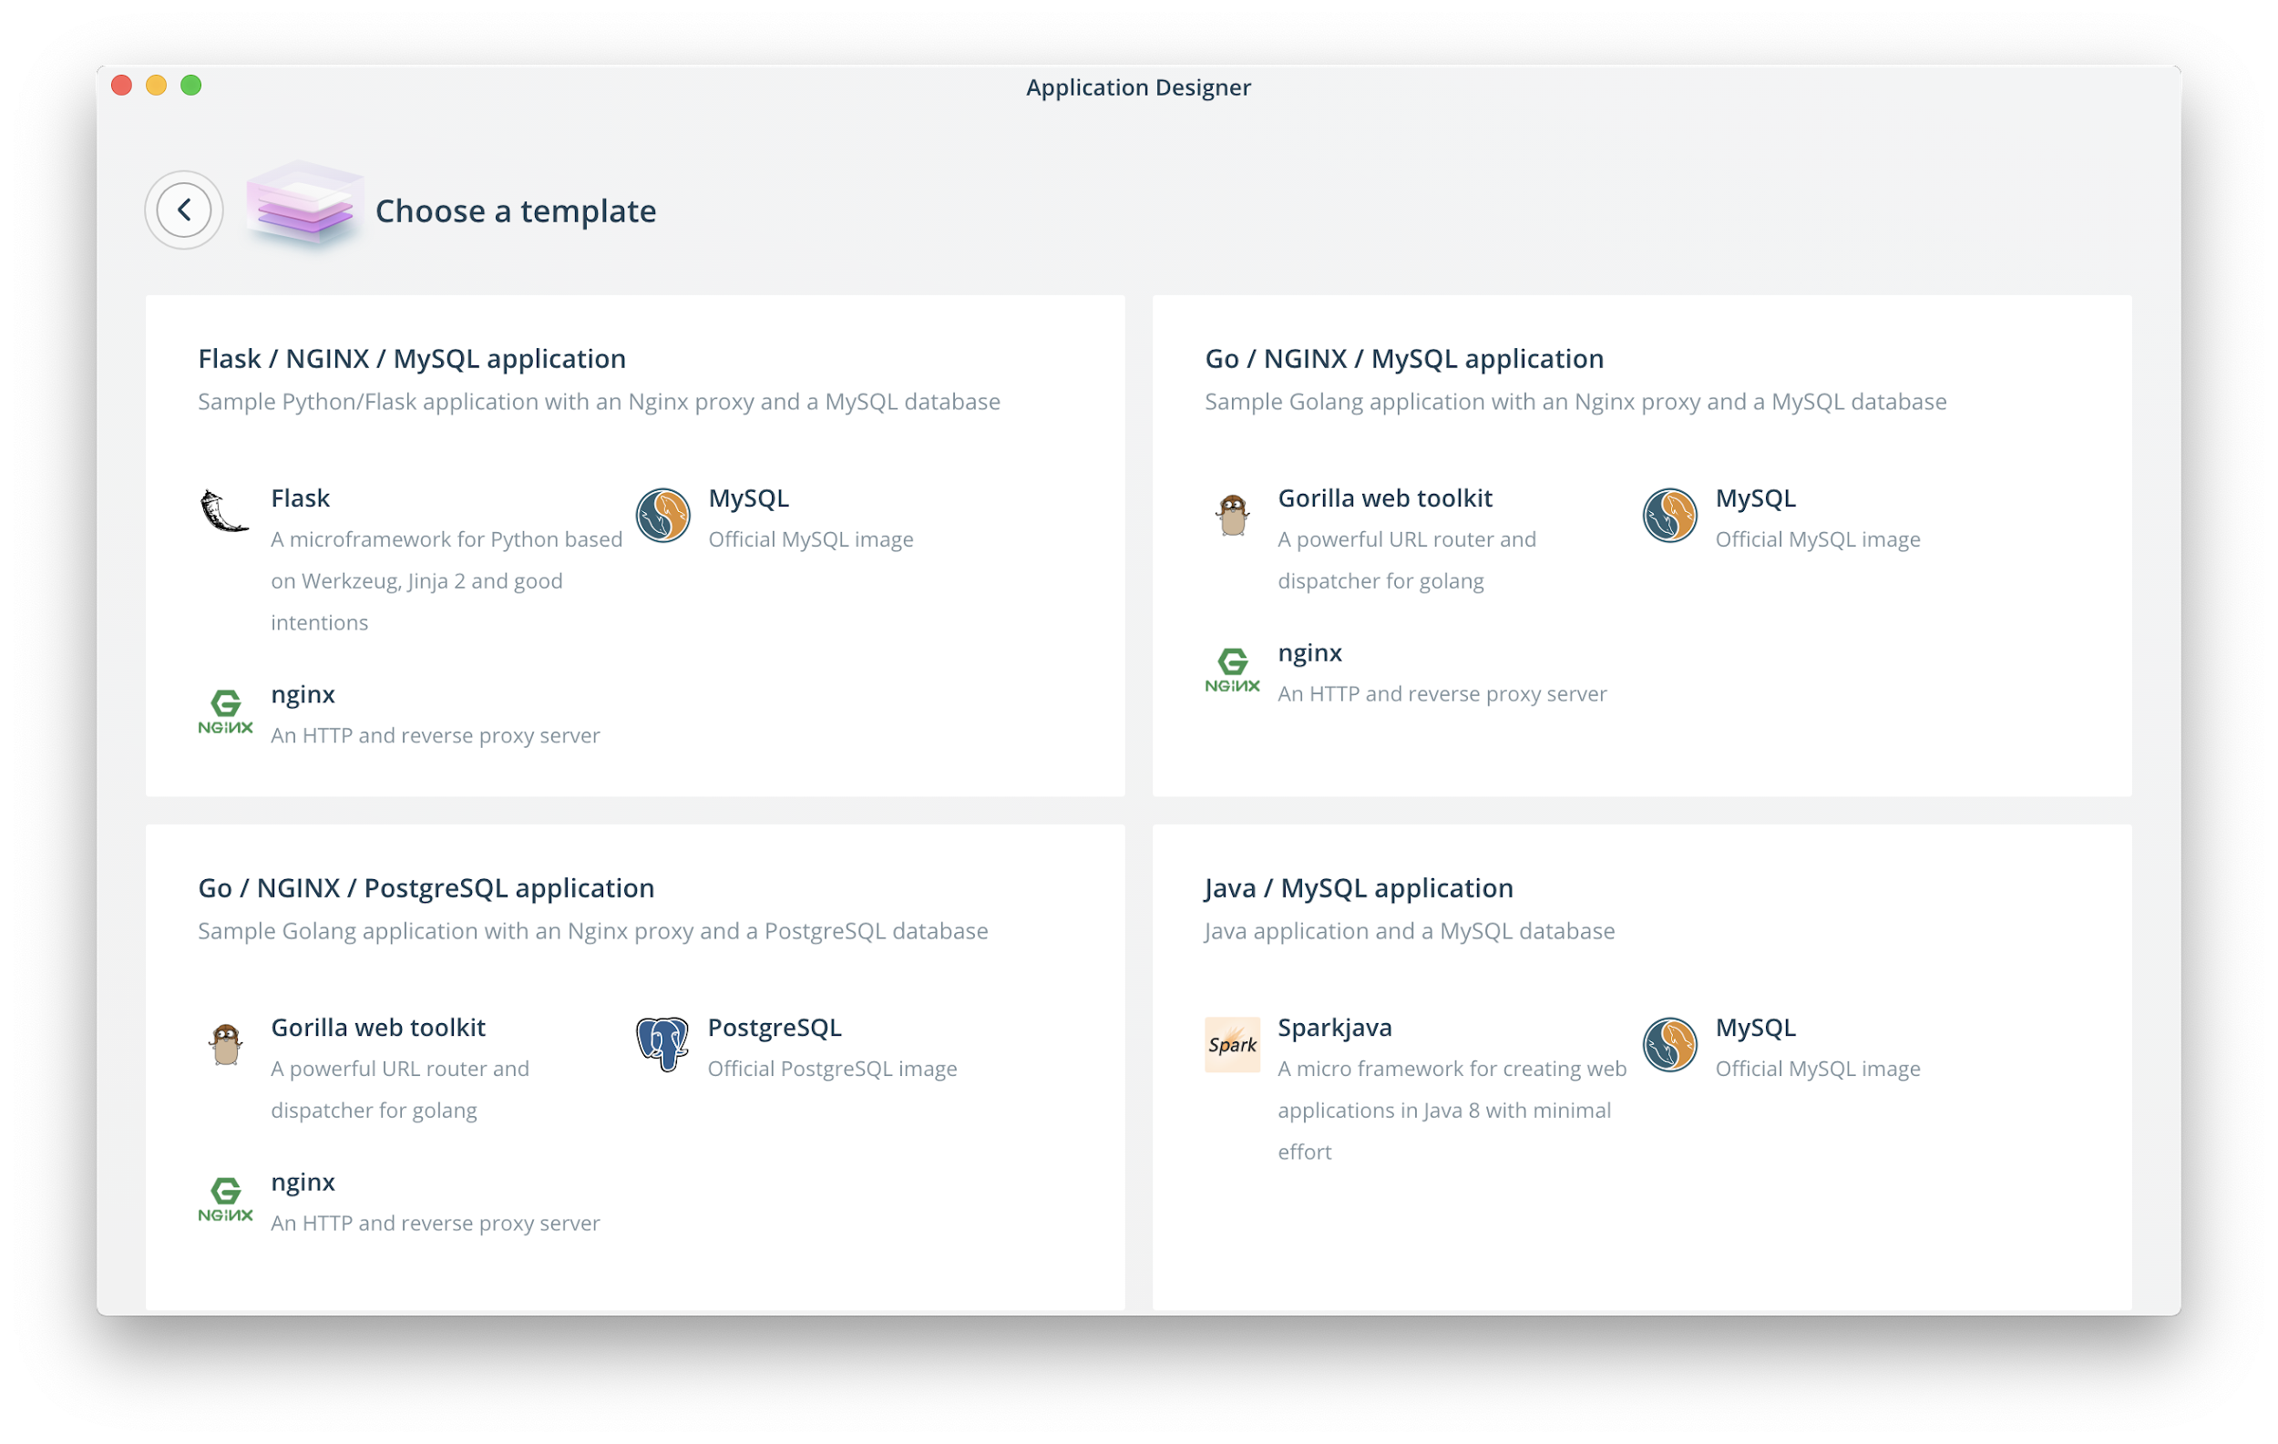
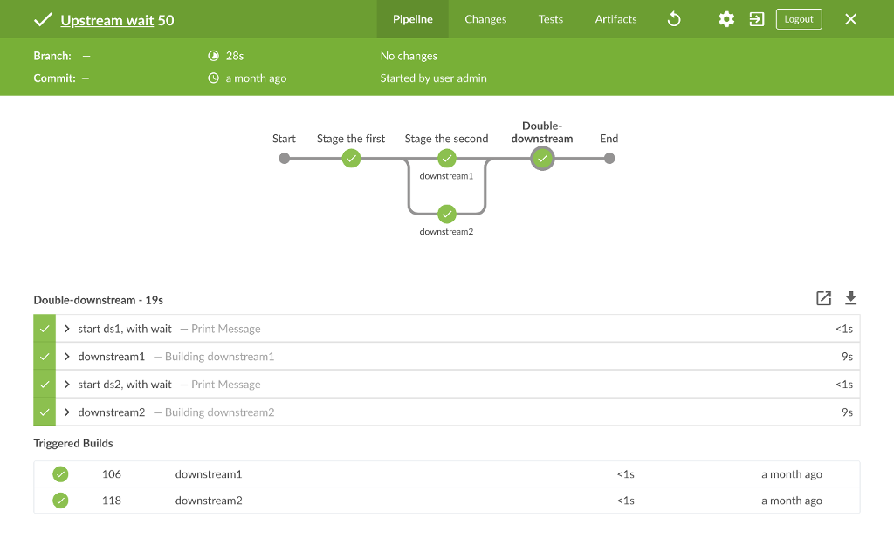
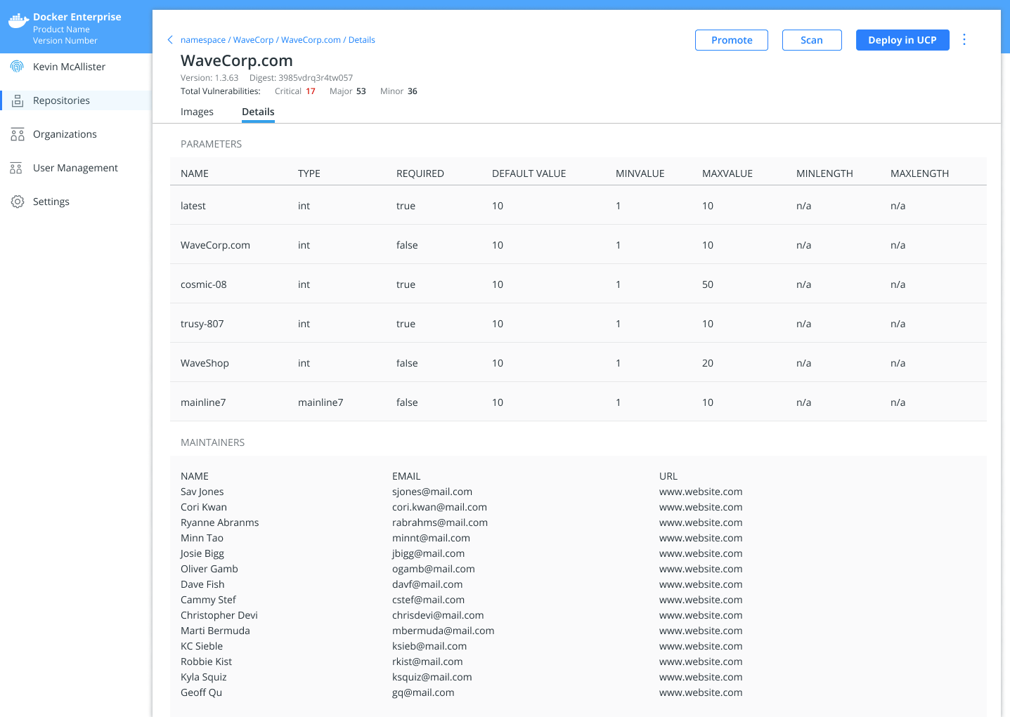
New Capabilities to Accelerate Containerization
Docker Desktop Enterprise
Application Templates
Docker Assemble
Supported Docker on Windows 10 and macOS.
Docker and Kubernetes for developers
Easy to install and manage for IT
Start new projects quickly, with all the required Docker configuration files.
SecOps builds templates for your Dev teams
GUI and CLI
Build Docker images for Spring Boot/Maven and .NET Core without Dockerfile.
No need to be a Docker expert
More constrained build for security conscious environments
$ docker assemble build .
Docker App
Docker Pipeline
Apps in UCP and DTR
Share Compose-based applications in DTR or Docker Hub
Facilitates dev to ops handoff
Implements the new CNAB spec
Start new projects quickly, with all the required Docker configuration files.
Build templates for your team
GUI and CLI
Share apps on DTR and manage running app in UCP
See who maintains an app
Run multiple instances of the same app with different config
$ docker app install my/app
Notes:
Purpose here is to double click into the new innovations in Docker Enteprise 3.0 related to bringing new applications to market.
Things to highlight:
Docker Desktop: enables enterprise-ready container-based development. Fastest and most secure way to deliver containerized applications from development to production.
Significant value for customers in having a complete, end-to-end platform, from desktop to production, because it enforces app runtime environment consistency from beginning to end.
Significant differentiation: Neither Pivotal nor Red Hat yet have a commercially-supported desktop developer environment.
Docker App: A consistent way to build, share and run multi-service applications as a single object that can be deployed to any infrastructure.
Simplifies and streamlines working with containers - moving from individual images and containers to an application object that defines groups of images and containers and their interdependencies
Removes the need for “mountains of YAML” and eliminates configuration overhead
Removes friction between developers and operations when handing off applications
Application Templates: provide developers with certified base image templates that they can use to build applications. These can be configured by the customer and pulled from Docker Trusted Registry, using Docker’s Desktop development environment.
If customer wants to go deeper, you can set up a workshop or level II discussion into any particular area.

Slide 16
Thank You!

Slide 17
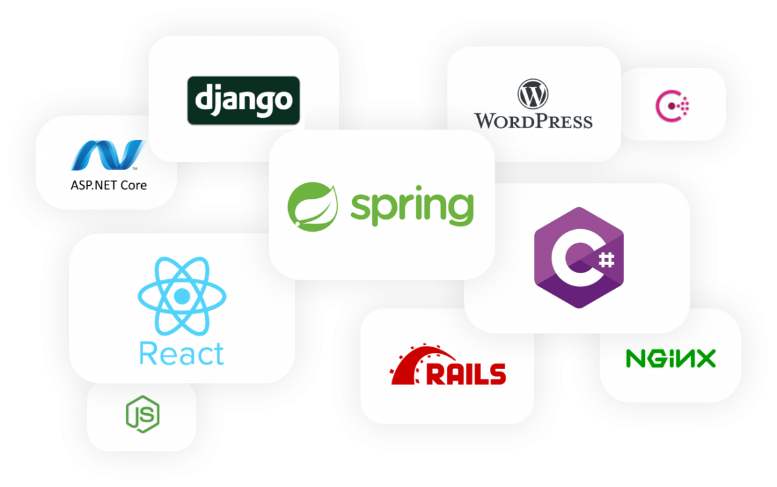
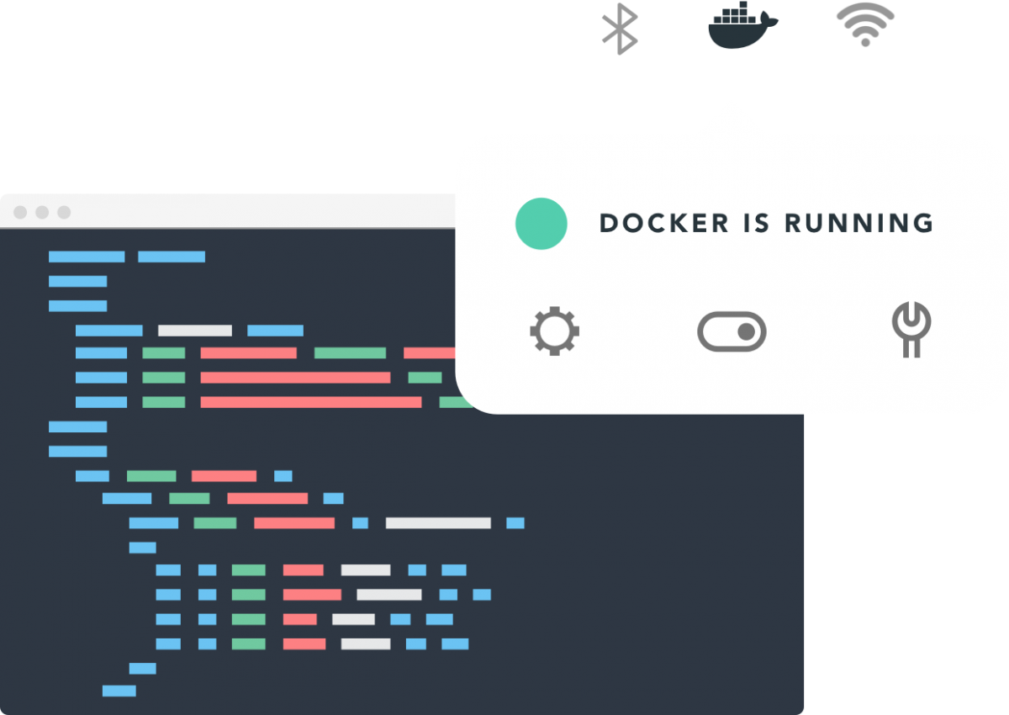
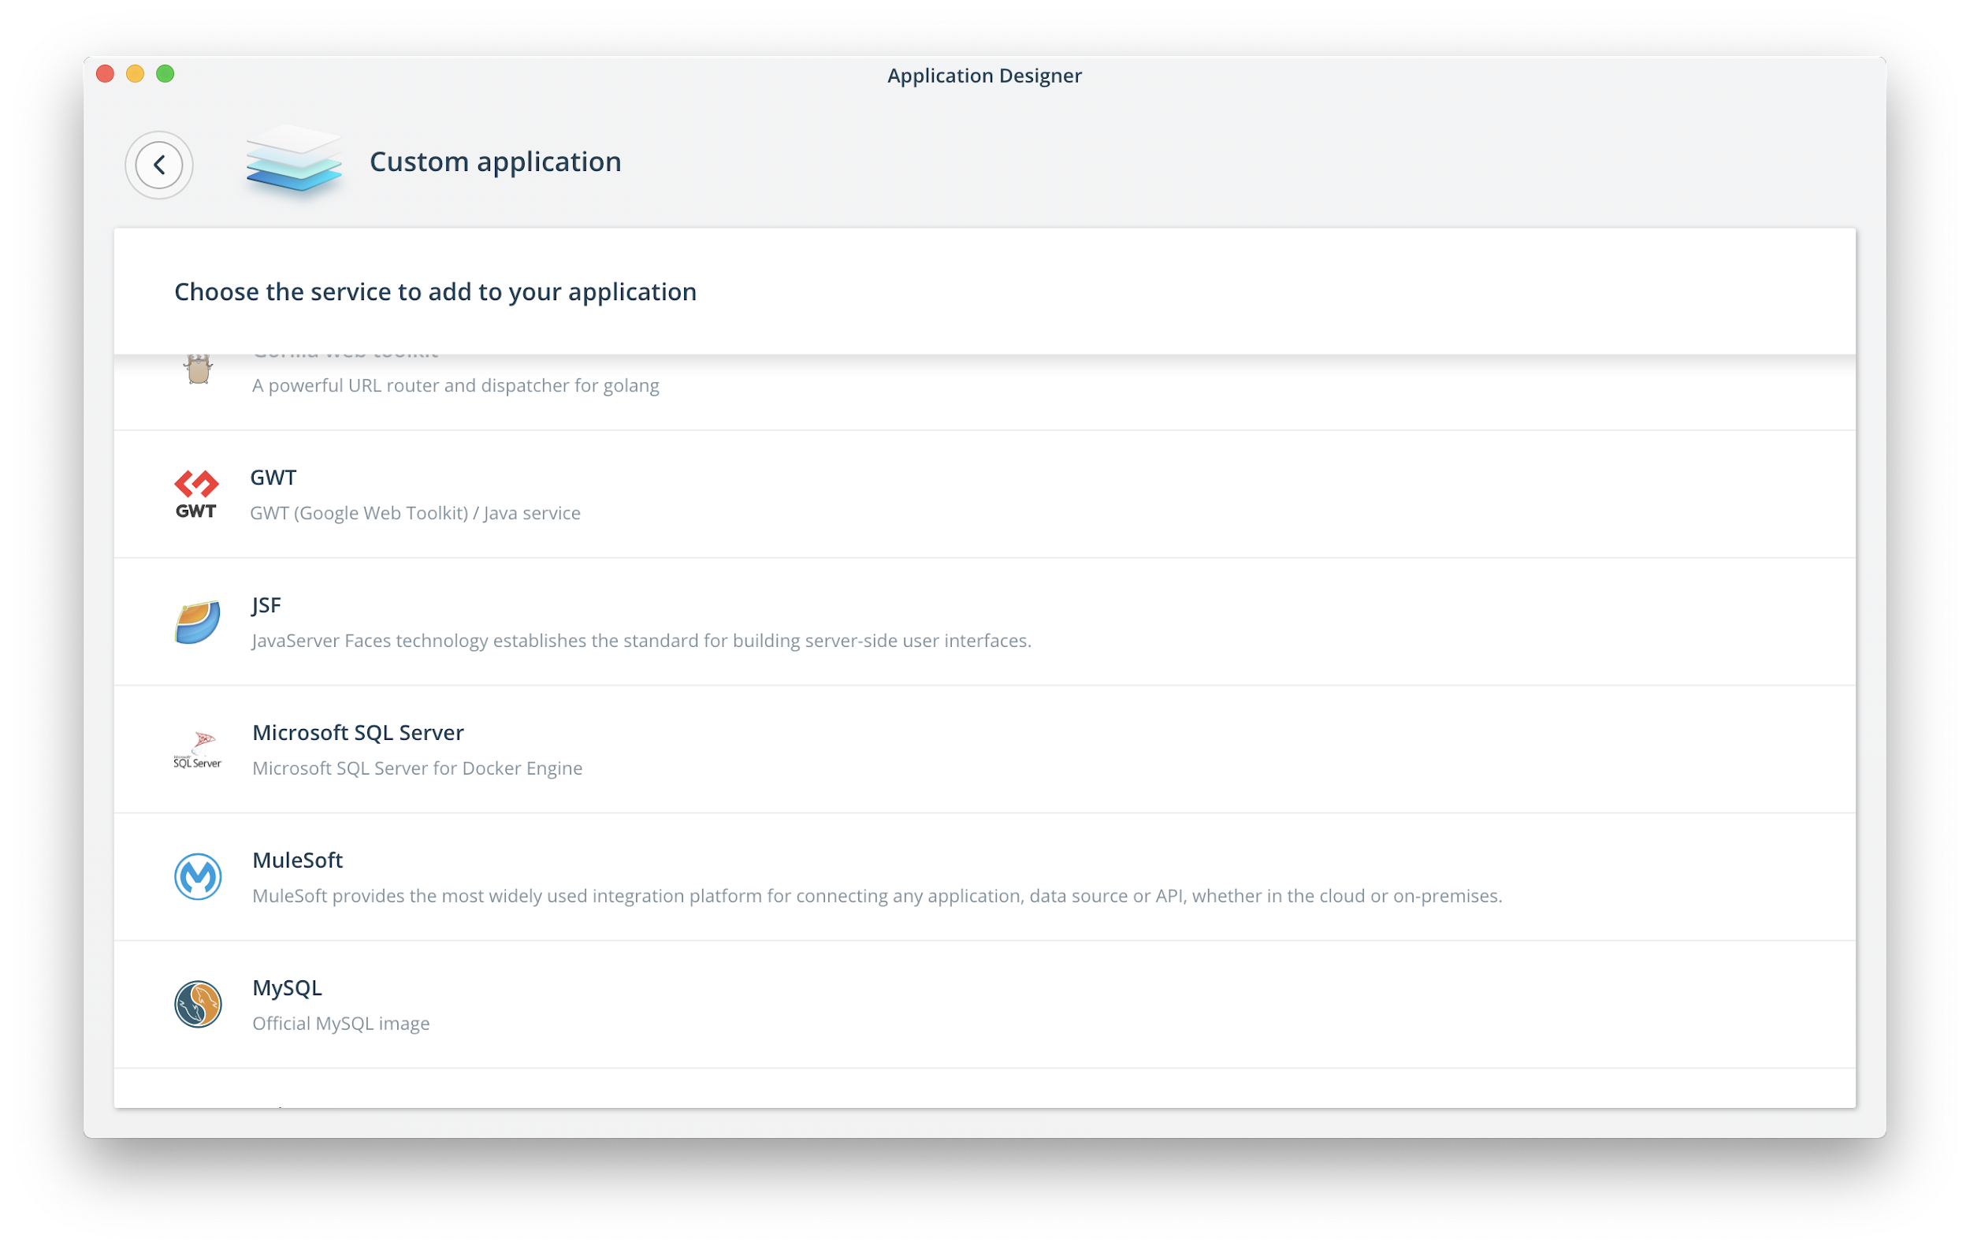
Unleash Modern App Development with the Easiest Path to Containers
Developer Choice
Fast & Simple
Continually Innovate
Develop in any language and framework
The only choice for Windows container development
Works with developers’ preferred tools: GUI or CLI
No manual configuration or extra setup required
No Docker or Kubernetes expertise required
Leverage templates to get started quickly
Fast local dev-test cycles
Mirror production on the desktop
Notes:
Choice
Docker Desktop Enterprise gives developers the freedom to work on their chosen frameworks and languages
Works with any application, framework, or language
The only choice for Windows container development
Flexibility to use Docker CLI or GUI-based workflows
Developer choice:
Installs on Mac or Win in minutes
Swarm & Kubernetes orchestrators built-in
Integrates with multiple IDEs and developer tools including Visual Studio, IntelliJ, Eclipse
Fastest & Simplest
Docker Desktop Enterprise makes it easy to build containerized applications
Familiar to millions of developers
Simple setup with no additional software or VM configuration required
Swarm & Kubernetes orchestrators built-in
Millions of developers:
Over 1.4M monthly active Docker Desktop developers (looker)
2M+ new developers downloaded Docker Desktop in the past year
74B+ container downloads (looker)
Simple setup:
Provides ready-to-use Docker Engine and orchestrators, with Kubernetes certification
Single installation package handles all configuration - no additional software or manual VM setup required
Continuous Innovation
Developers can rapidly and continuously innovate using production-ready application templates
Leverage company-provided application templates
Instantly replicate production-approved application configurations on the local desktop
App templates: Present developers with your customized and standardized application templates, ready for coding
Production-ready environments:
⭐“Version packs” - simple selection of Docker Engine and Kubernetes and Swarm orchestrators to match production environments
Improved developer productivity:
⭐App Designer UI: no Docker CLI commands required to get images & start an app running in containers
Includes configurable / lockable template index
Multiple IDEs have plugins (VS, IntelliJ, eclipse…)
Kubernetes Certified

